Slide 1

Course Project CISC3002
Zhang Huakang
DB927606

Slide 2
Introduction
This application named King of Karaoke is a quiz game about music. Users will login in with their account(they can use Google Account), answer several question which are randomly selected from a question's library within the specified time, finally submit their score to the server and let other users know their grade.
In this project, I use Java and Android SDK to develop the front-end application. As for the back end which is used to store data, I use Python and Django Framework to develop it.
Since the course focuses on Android application development, I will not go into details about the specific implementation of the back-end. The source code of the whole project and other data used in this was upload to Github.

Slide 3
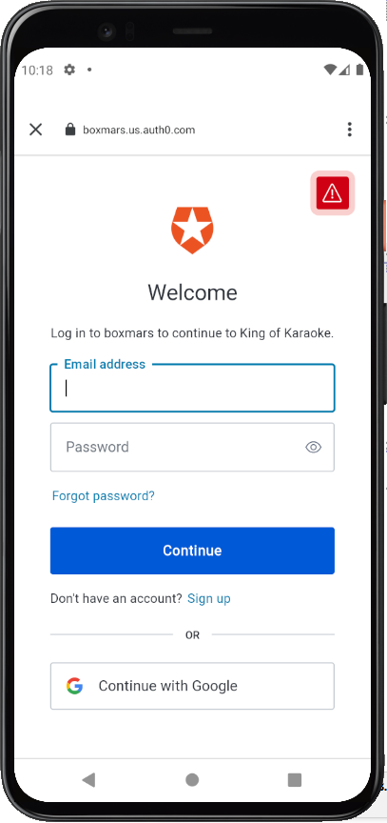
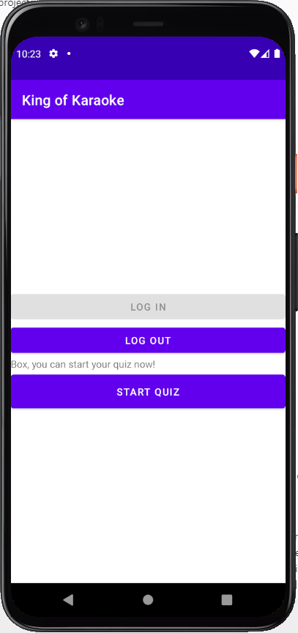
Details-Login/ Logout
The third-party services Auth0

Slide 4
Details-Update data
VERSION_API
SONGS_API:
Those information will be stored in application's internal storage. A DownloadAsynTask will start to download all music and store them in internal storage.
[
{
"song": "Chocolate",
"singer": "Alfonso Lugo",
"songURL": "https://github.com/BoxMars/AndroidDevCourseProject/raw/master/static/Alfonso_Lugo_-_Chocolate.mp3"
},
{
"song": "Study and Relax",
"singer": "D JAY KOI",
"songURL": "https://github.com/BoxMars/AndroidDevCourseProject/raw/master/static/D_JAY_KOI_-_HOUSE_PARTY_._Feat_Fil_Straughan__.mp3"
},
...
...
...
]

Slide 5
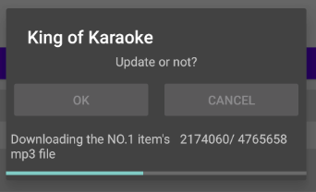
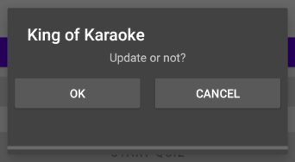
Details-Downloading

Slide 6
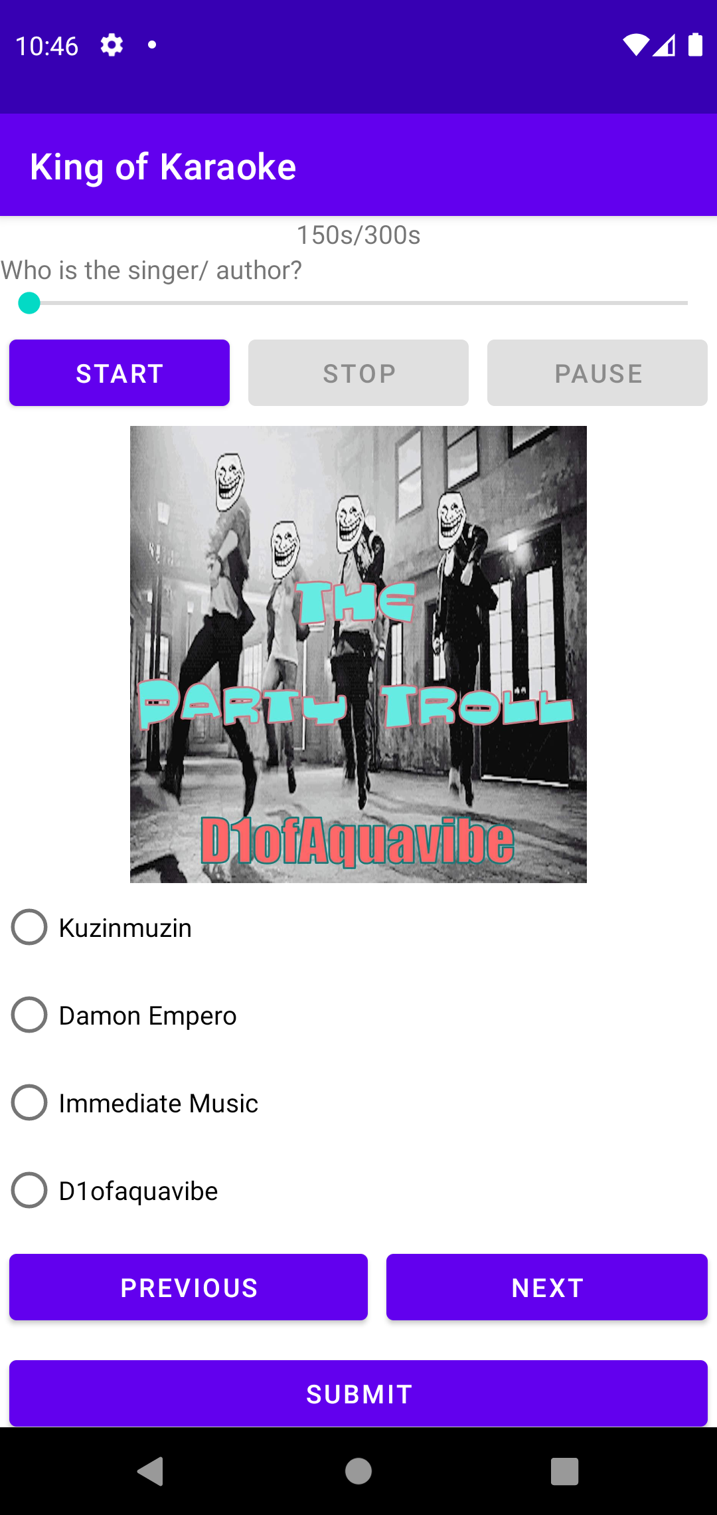
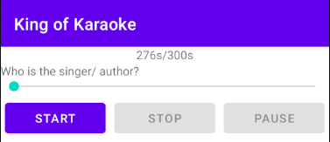
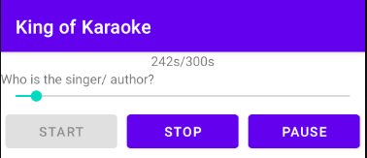
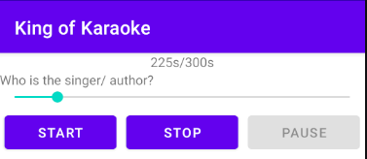
Details-Quiz
Countdown timer
Music player
Cover image
Four radio buttons
Three buttons
Previous
Next
Submit

Slide 7
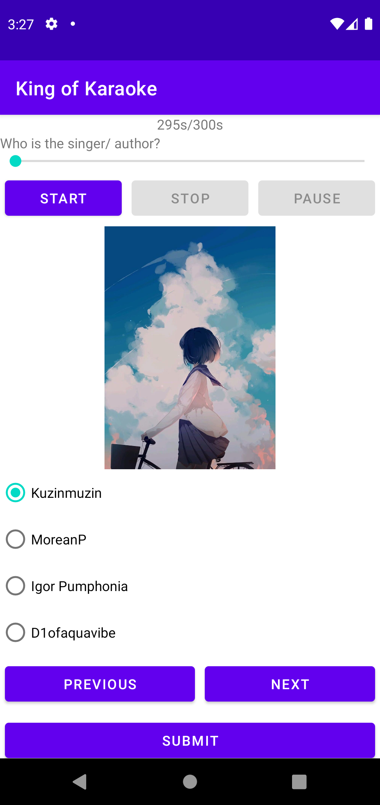
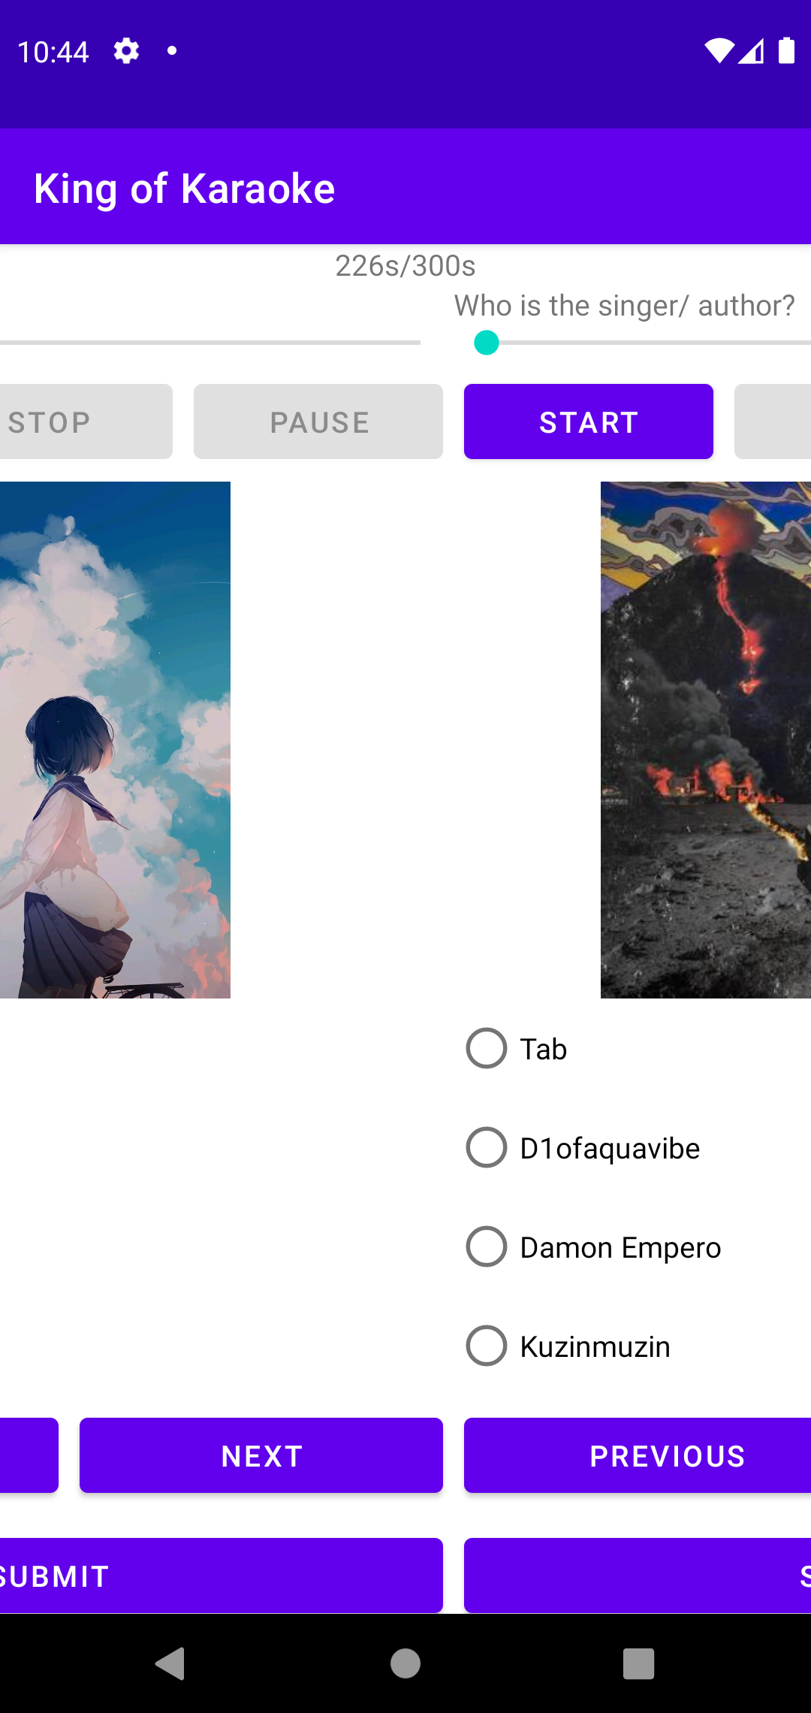
Details-Quiz
Every question are chosen from question library randomly, and the option of each question are also randomly generated.
The function that several questions can be swiped on the screen is implemented by ViewPage2 and Fragment. The two buttons at the bottom can also be used to browse between different questions.

Slide 8
Details-The random questions
ArrayList<Question> questionArrayList=new ArrayList<>();
Random random=new Random();
while (questionArrayList.size()<=Math.min(8,Question.questionArrayList.size())){
int result=random.nextInt(Question.questionArrayList.size());
if (!questionArrayList.contains(Question.questionArrayList.get(result))){
questionArrayList.add(Question.questionArrayList.get(result));
}
}
Question.questionArrayList=questionArrayList;
Question.generateOption();
The application will choose 8 question randomly and update the question list.

Slide 9
Details-The random questions
public static void generateOption(){
isCorrectList=new ArrayList<>();
userAnswer=new ArrayList<>();
for (int i = 0; i < questionArrayList.size(); i++) {
ArrayList<Integer> options=new ArrayList<>();
Random random=new Random();
while(options.size()<=3){
int result=random.nextInt(questionArrayList.size());
if (result!=i&&!options.contains(result)){
options.add(result);
}
}
int result=random.nextInt(4);
options.add(result,i);
questionArrayList.get(i).setOptions(options);
questionArrayList.get(i).setAnswer(result);
isCorrectList.add(false);
userAnswer.add(4);
}
}
The application will choose 3 other question’s answer, mix them with the answer into an array and store them in the object.
Initialize isCorrectList and userAnswer.
while(options.size()<=3){
int result=random.nextInt(questionArrayList.size());
if (result!=i&&!options.contains(result)){
options.add(result);
}
}

Slide 10
Details-Countdown Timer
countDownTimer=new CountDownTimer(300000,1000) {
@Override
public void onTick(long millisUntilFinished) {
TextView textView=findViewById(R.id.timerTextView);
textView.setText(millisUntilFinished/1000+"s/300s");
}
@Override
public void onFinish() {
Intent intent1=new Intent();
intent1.setClass(getApplicationContext(),ScoreActivity.class);
startActivity(intent1);
}
};
countDownTimer.start();
User can submit his/her answers before within the specified time, or answers are automatically submitted, when time runs out.

Slide 11
Details-Cover image
MediaMetadataRetriever mmr = new MediaMetadataRetriever();
mmr.setDataSource(String.valueOf(new File(getActivity().getFilesDir(),"mp3 file name")));
byte [] data = mmr.getEmbeddedPicture();
Bitmap bitmap = BitmapFactory.decodeByteArray(data, 0, data.length);
imageView.setImageBitmap(bitmap);
The cover image are directly from MP3 file's metadata. I use MediaMetadataRetriever to decode the information and show it on the screen.

Slide 12
Details-Music Seek Bar
When the music starts, there will be a handler to get the current music playback progress and pass the data to seekbar.
Handler handler=new Handler(Looper.myLooper());
Runnable runnable=new Runnable() {
@Override
public void run() {
if(mediaPlayer!=null)
{
seekBar.setProgress(mediaPlayer.getCurrentPosition());
handler.postDelayed(this, 200);
}
}
};
mediaPlayer.start();
seekBar.setMax(mediaPlayer.getDuration());
handler.postDelayed(runnable,200);

Slide 13
Details-Previous and Next button
The buttons Previous and Next are in the Fragment. So, when we try to control the fragment by buttons:
ViewPager2 viewPager2=getActivity().findViewById(R.id.viewPage);
nextBtn.setOnClickListener(new View.OnClickListener() {
@Override
public void onClick(View v) {
if (viewPager2.getCurrentItem()<Question.questionArrayList.size()) {
viewPager2.setCurrentItem(viewPager2.getCurrentItem() + 1, true);
}
}
});
previousBtn.setOnClickListener(new View.OnClickListener() {
@Override
public void onClick(View v) {
if (viewPager2.getCurrentItem()>0) {
viewPager2.setCurrentItem(viewPager2.getCurrentItem() - 1, true);
}
}
});

Slide 14
Details-Submit
When user click the Submit button in Quiz activity, the Score activity will be called. At the begin of the activity starts, the application will calculate the user's score and send the result to the server by the SUBMIT_API: https://API_SERVER/submitrank/?username=test&email=test@test.com&score=8.
Then the application will request to get the record of all users by GETRANK_API. The following JSON data is an example:
[
{
"username": "Box",
"email": "test@gmail.com",
"score": 0
}
...
]

Slide 15
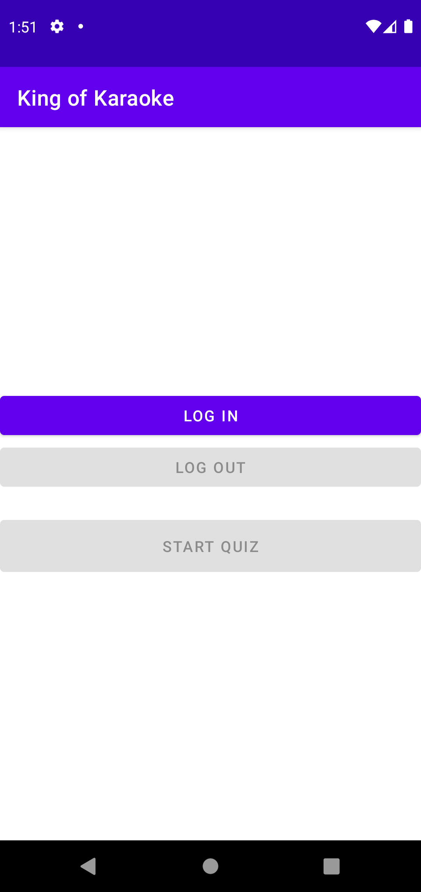
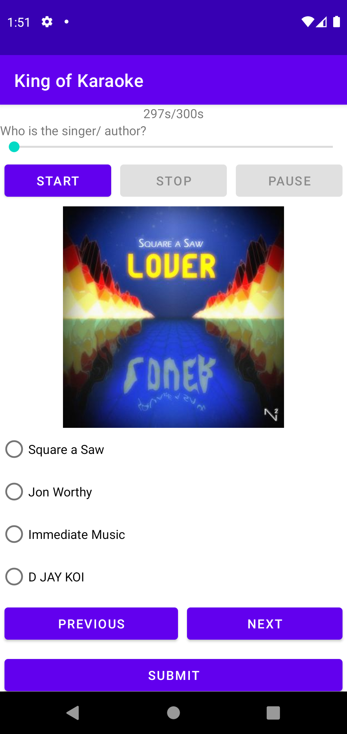
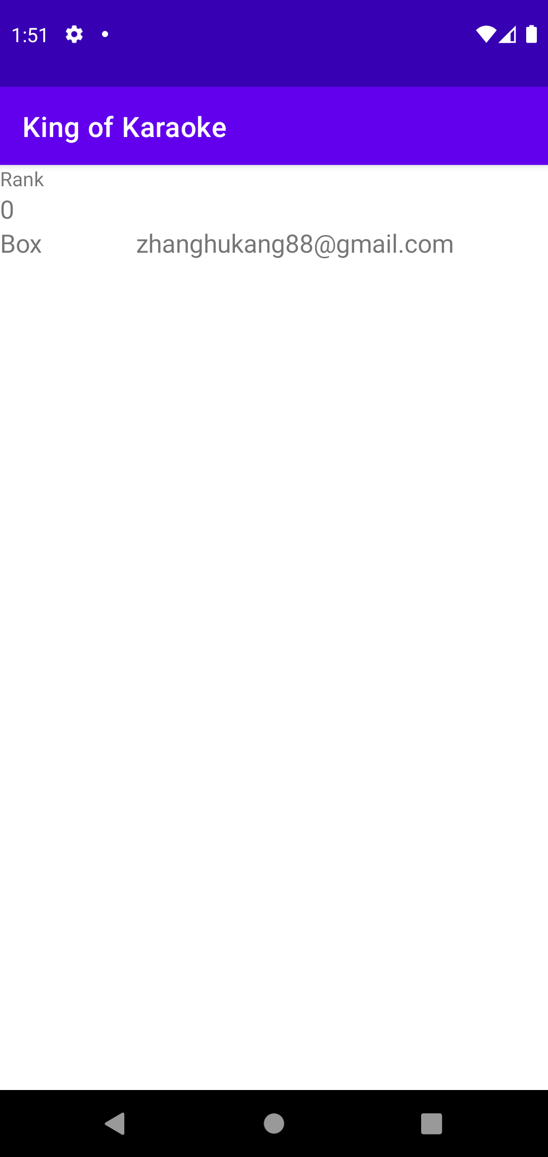
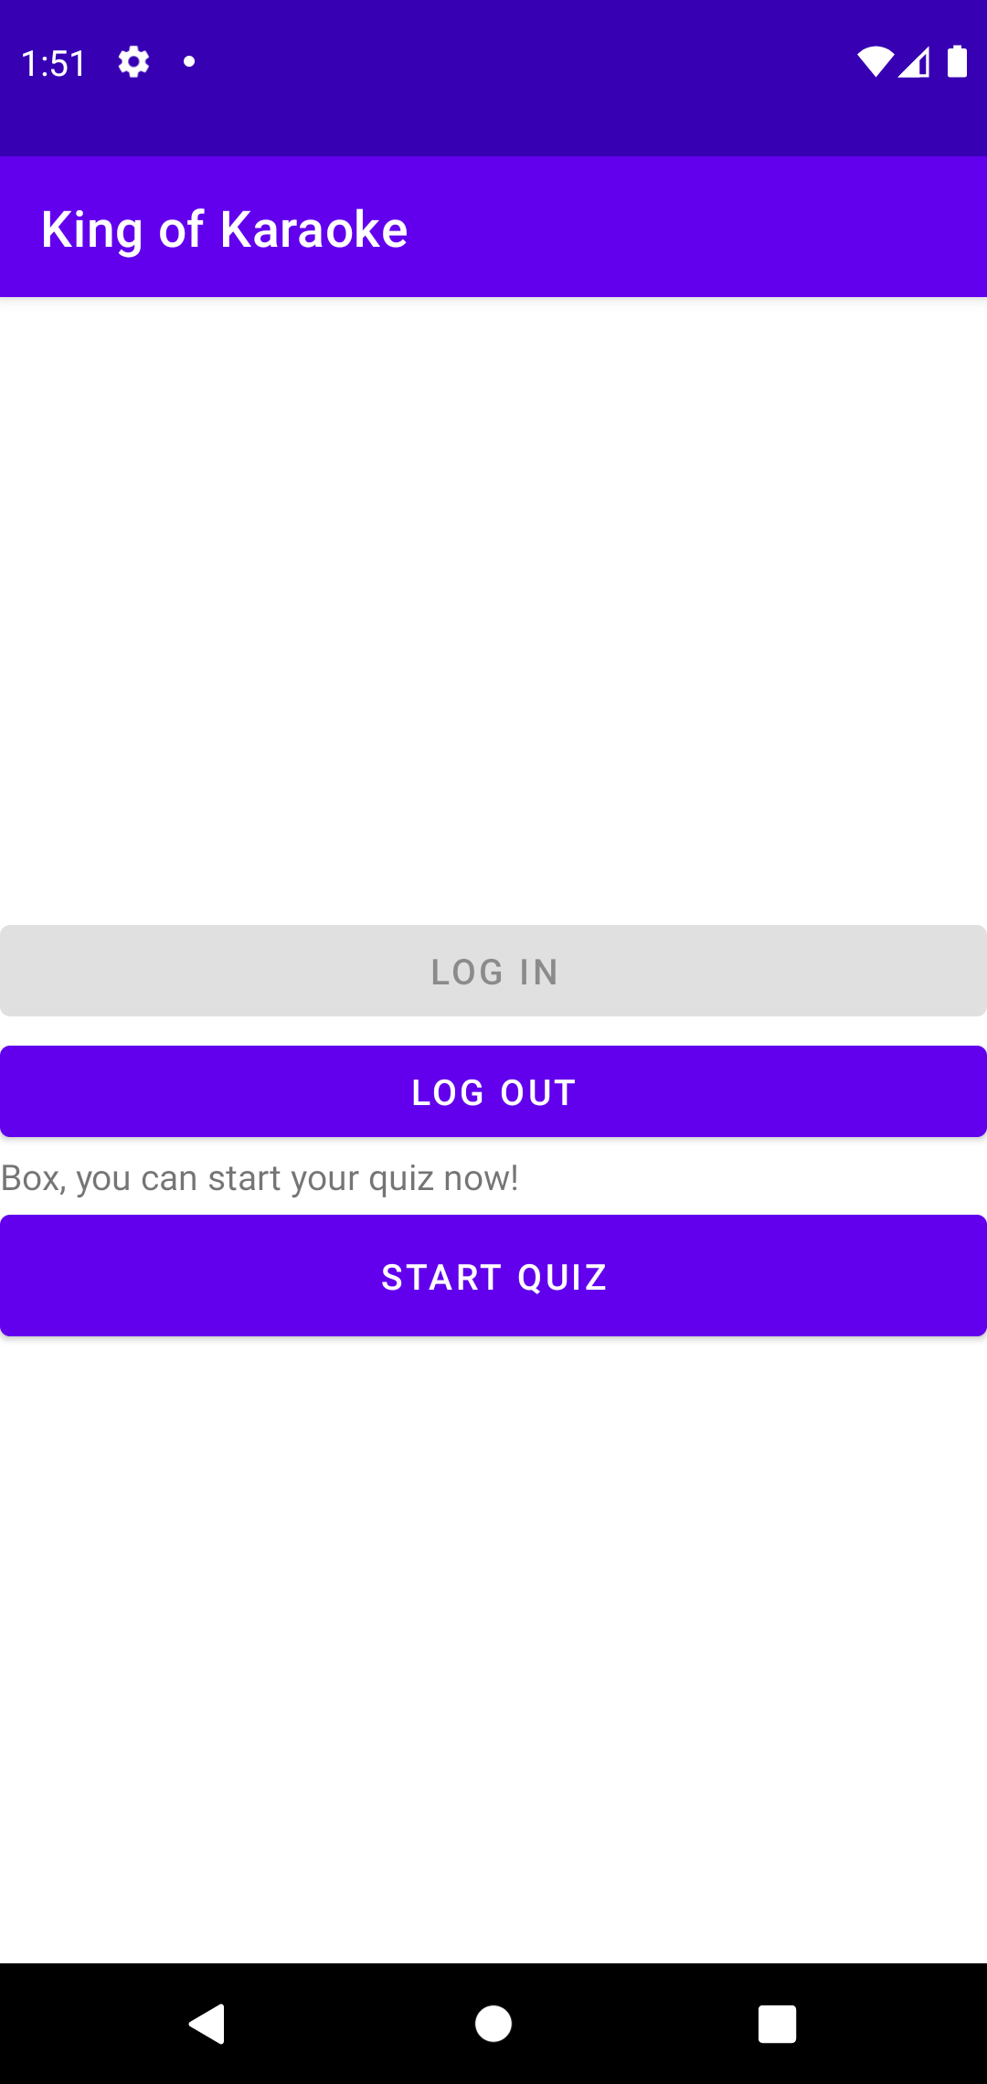
Details-Life-cycle of App

Slide 16
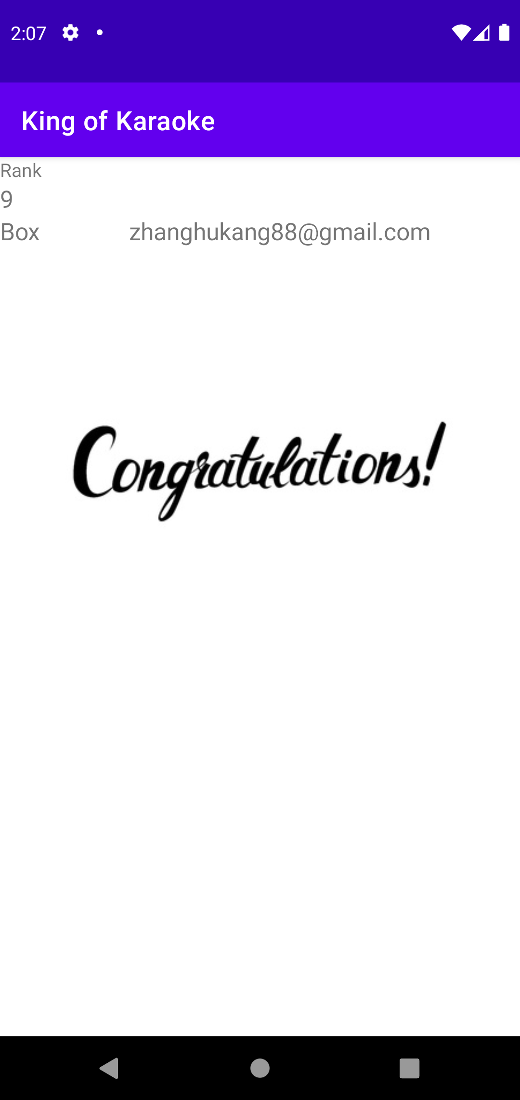
Details- Full marks
If user get full mark, a congratulation image will be shown.

Slide 17
Implementations-Rotation
Due to the characteristics of the Java Virtual Machine, the static variables in the class will always exist from the time the class is loaded to the end of the program. Thus, I did not use ViewModel but chose to set all the variables that need to be used throughout the life cycle of the program into static variables, which means no matter how the program status changes, all data is correctly stored and displayed before the program ends. The following code is an example:
public class Question implements Serializable {
public static ArrayList<Question> questionArrayList=new ArrayList<>();
public static ArrayList<Integer> userAnswer=new ArrayList<>();
public static ArrayList<Boolean> isCorrectList=new ArrayList<>();
}

Slide 18

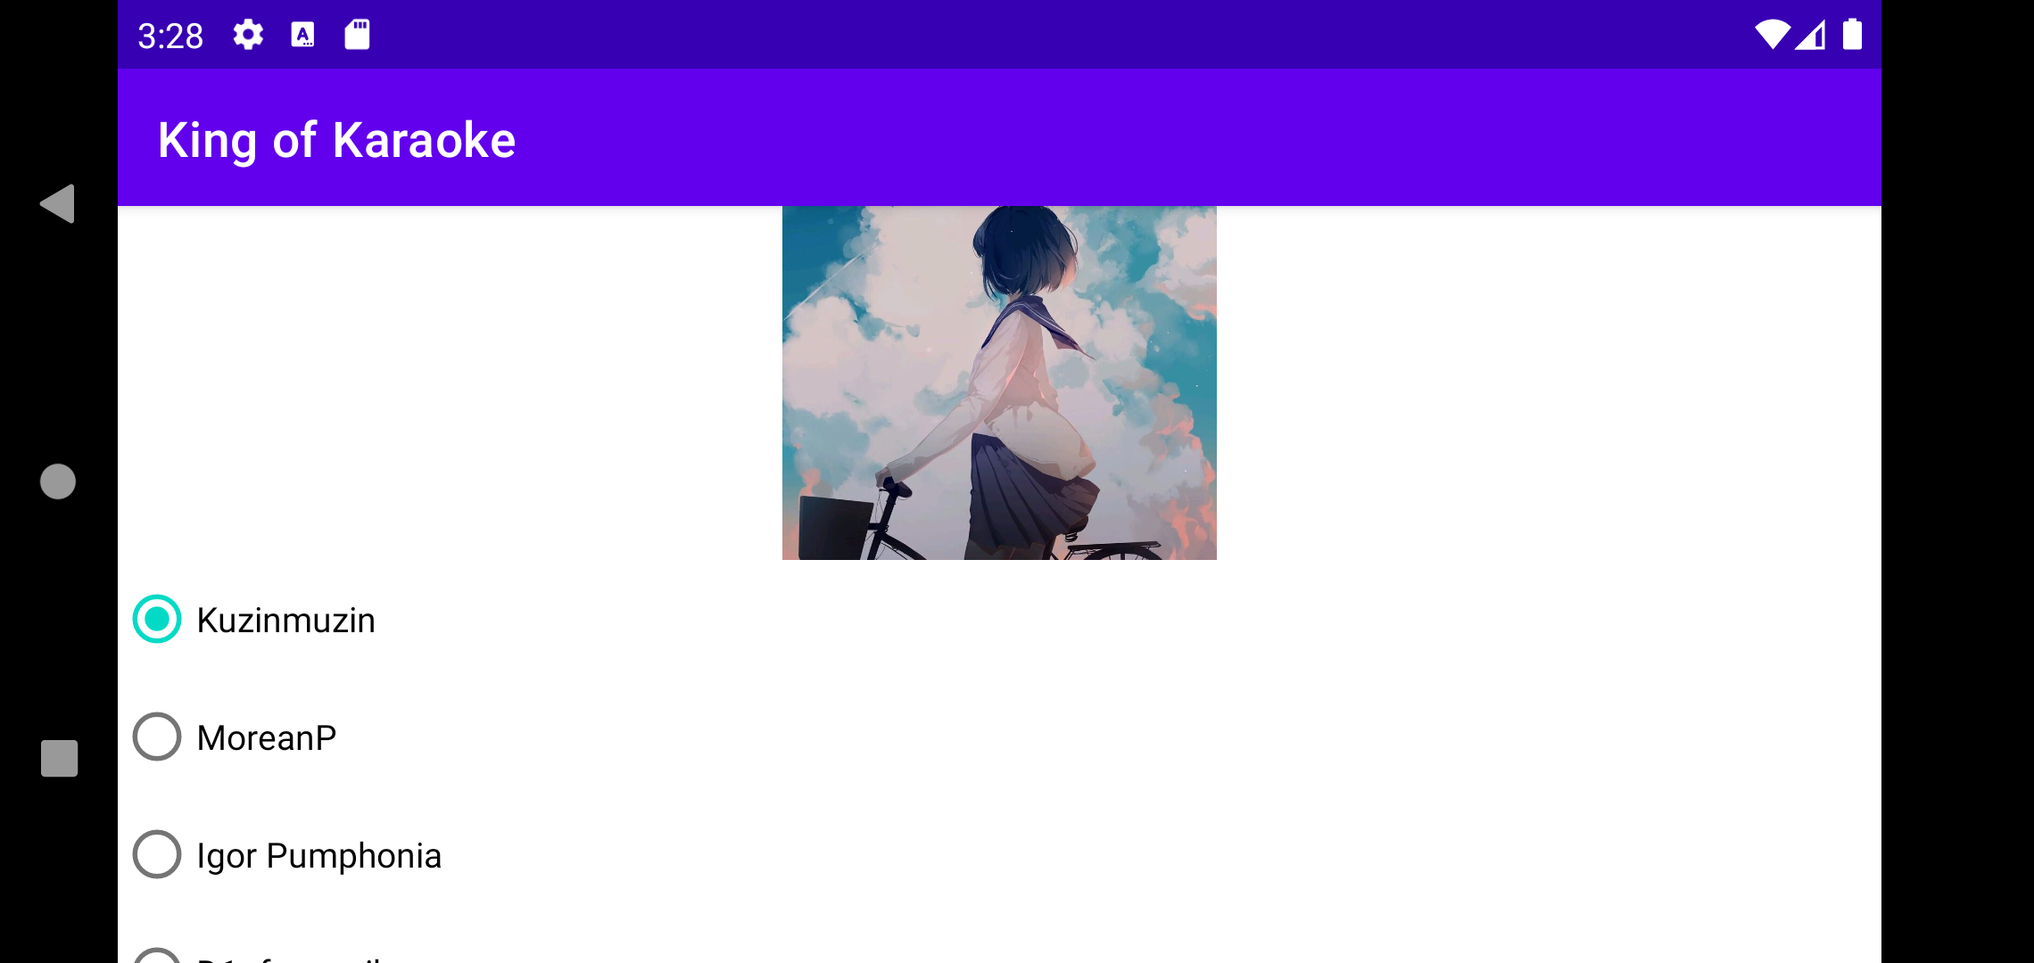
Implementations-Rotation
The questions, answers are static variables. So, when user rotates his/her phone in Quiz Activity, the user's answers and the order of the questions will no change.

Slide 19
Handling of Exceptions
No Internet
Since the Login/Logout activity need Internet, the whole application will never go further if there is no Internet connection
No local file or downloading error
If there is no local file, the version number will be -1, it will compare with the server version number and call the Update activity. If user chooses No button in Update activity, the application will toast an error message. Since no data is read in memory, when user clicks the Start Quiz, the application will also toast an error message and not go further to prevent errors.
If there is a downloading error, the file will not be stored correctly. When the application read the file, the program will throw an exception, and the exception will be caught and handled.

Slide 20
Conclusion
Overall, we can divide the entire project into two parts: the front end and the back end. The back end is responsible for storing data and processing user requests, while the front end provides a user interface to display data. In this application, the main data are getting from the server. The front-end and back-end separation architecture model is more conducive to the development of applications for other platforms.
About new version, in my opinion, the user interface can be optimized. We can also develop the forum function so that users can communicate and share with each other, not just the score ranking.

